Slide 1
CPSC 351
Operating Systems Concepts
Processes Part II

Slide 2
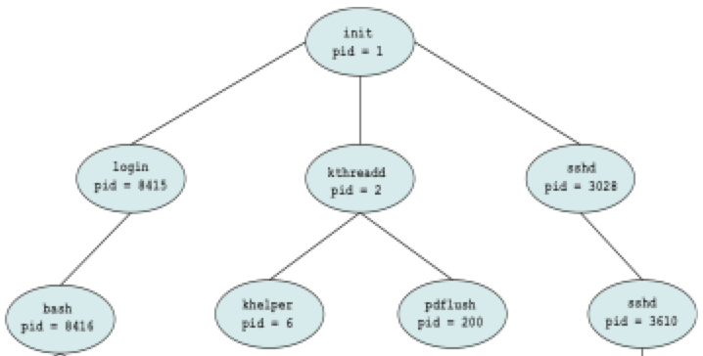
Computer Startup
Bootstrap program is loaded at power-up or reboot
Typically stored in read-only memory (ROM) or electrically erasable programmable read-only memory (EEPROM), generally known as firmware
Initializes all aspects of system
Loads operating system kernel and starts execution
Some system programs outside of the kernel are loaded into memory at boot time to become system processes, or system daemons
On UNIX/Linux, the first system process is “init” that starts other daemons
init process always with a pid of 1 serves as the root parent process for all user processes

Slide 3
Operations on Processes
System must provide mechanisms for
Process creation
Process Termination

Slide 4

Process Creation

Slide 5
Process Creation
Parent process create children processes, which, in turn create their own child (grandchild) processes, forming a tree of processes
process identified and managed via a process identifier (pid)

Slide 6
Process Creation (2)
Resource sharing options
Parent and children share all resources
Children share subset of parent’s resources
Parent and child share no resources
Execution options
Parent and children execute concurrently
Parent waits until children terminate
Address space
Child duplicate of parent
Child has a program loaded into it

Slide 7
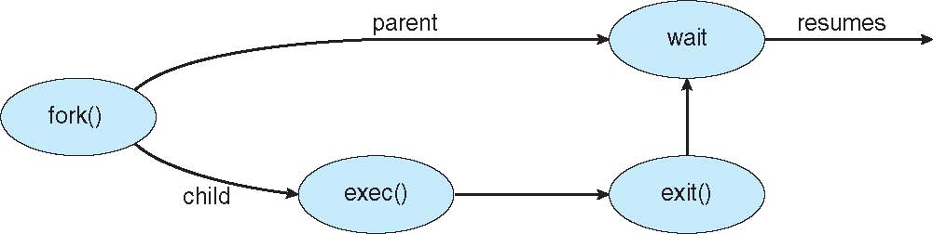
Unix Process Creation
fork() system call creates new process
exec() system call used after a fork() to replace the process’ memory space with a new program

Slide 8
Process Creation in Unix/Linux: fork()
fork() - a system call is issued by a parent process to create a child process
Child process is a clone of a parent process
Both parent and child continue execution at the instruction immediately after fork():
In the child fork() returns 0
In the parent fork returns process id (pid) of the child
fork() returns -1 on failure
The child process inherits:
The set of files opened by the parent process
Other resources…

Slide 9
Process Creation in Unix/Linux: exec()/wait()/exit()
exec(…) – replaces the program of the caller process with a new program
wait(…) – waits until the child terminates
exit(int exitcode) – terminates the caller process with the specified exit code

Slide 10
Process Creation in Unix/Linux: exec() variants
int execl(const char *path, const char *arg, ...);
int execlp(const char *file, const char *arg, ...);
int execle(const char *path, const char *arg,..., char * const envp[]);
int execv(const char *path, char *const argv[]);
int execvp(const char *file, char *const argv[]);
int execvpe(const char *file, char *const argv[], char *const envp[]);
Example: execlp(const char *file, const char *arg, ...);
file: the path of the executable image
arg0…argn: command line arguments to pass to the process
All return -1 on failure

Slide 11
Process Creation in Unix/Linux: wait() variants
wait() and waitpid() return the process id of the child
pid_t wait(int *status);
pid_t waitpid(pid_t pid, int *status, int options);
waitid() return 0 on success and -1 on faliure
int waitid(idtype_t idtype, id_t id, siginfo_t *infop, int options);

Slide 12
Process Creation in Unix/Linux: Putting it all Together
// Parent process
int main()
{
pid_t pid;
/* fork another process */
pid = fork();
if (pid < 0) { /* error occurred */
fprintf(stderr, "Fork Failed");
exit(-1);
}
else if (pid == 0) { /* child process */
execlp("/bin/ls", "ls", NULL);
}
else { /* parent process */
/* parent will wait for the child to
complete */
wait (NULL);
printf ("Child Complete");
exit(0);
}
}
Start with the parent process
Parent process issues a folk() system call

Slide 13
fork() clones the parent process ➔ Both parent & child continue by executing the next instruction after fork()
// Parent process
int main()
{
pid_t pid;
/* fork another process */
pid = fork();
if (pid < 0) { /* error occurred */
fprintf(stderr, "Fork Failed");
exit(-1);
}
else if (pid == 0) { /* child process */
execlp("/bin/ls", "ls", NULL);
}
else { /* parent process */
/* parent will wait for the child to
complete */
wait (NULL);
printf ("Child Complete");
exit(0);
}
}
// Child process
int main()
{
pid_t pid;
/* fork another process */
pid = fork();
if (pid < 0) { /* error occurred */
fprintf(stderr, "Fork Failed");
exit(-1);
}
else if (pid == 0) { /* child process */
execlp("/bin/ls", "ls", NULL);
}
else { /* parent process */
/* parent will wait for the child to
complete */
wait (NULL);
printf ("Child Complete");
exit(0);
}
}

Slide 14
In parent, fork() returns child’s process ID
In child, fork() returns pid of 0
// Parent process
int main()
{
pid_t pid;
/* fork another process */
pid = fork();
if (pid < 0) { /* error occurred */
fprintf(stderr, "Fork Failed");
exit(-1);
}
else if (pid == 0) { /* child process */
execlp("/bin/ls", "ls", NULL);
}
else { /* parent process */
/* parent will wait for the child to
complete */
wait (NULL);
printf ("Child Complete");
exit(0);
}
}
// Child process
int main()
{
pid_t pid;
/* fork another process */
pid = fork();
if (pid < 0) { /* error occurred */
fprintf(stderr, "Fork Failed");
exit(-1);
}
else if (pid == 0) { /* child process */
execlp("/bin/ls", "ls", NULL);
}
else { /* parent process */
/* parent will wait for the child to
complete */
wait (NULL);
printf ("Child Complete");
exit(0);
}
}

Slide 15
Parent issues a wait(…) system call to wait until the child terminates
Child issues a execlp() system call to replace its executable image with that of ls command
// Parent process
int main()
{
pid_t pid;
/* fork another process */
pid = fork();
if (pid < 0) { /* error occurred */
fprintf(stderr, "Fork Failed");
exit(-1);
}
else if (pid == 0) { /* child process */
execlp("/bin/ls", "ls", NULL);
}
else { /* parent process */
/* parent will wait for the child to
complete */
wait (NULL);
printf ("Child Complete");
exit(0);
}
}
// Child process
int main()
{
pid_t pid;
/* fork another process */
pid = fork();
if (pid < 0) { /* error occurred */
fprintf(stderr, "Fork Failed");
exit(-1);
}
else if (pid == 0) { /* child process */
execlp("/bin/ls", "ls", NULL);
}
else { /* parent process */
/* parent will wait for the child to
complete */
wait (NULL);
printf ("Child Complete");
exit(0);
}
}

Slide 16
Parent waits (in wait(…)) for the child process to terminate
ls command executes starting from the first instruction; original child code is destroyed
// Parent process
int main()
{
pid_t pid;
/* fork another process */
pid = fork();
if (pid < 0) { /* error occurred */
fprintf(stderr, "Fork Failed");
exit(-1);
}
else if (pid == 0) { /* child process */
execlp("/bin/ls", "ls", NULL);
}
else { /* parent process */
/* parent will wait for the child to
complete */
wait (NULL);
printf ("Child Complete");
exit(0);
}
}
// Child process
ls command code

Slide 17
wait(…) returns, and parent process executes the next instruction
ls command finishes execution and terminates
// Parent process
int main()
{
pid_t pid;
/* fork another process */
pid = fork();
if (pid < 0) { /* error occurred */
fprintf(stderr, "Fork Failed");
exit(-1);
}
else if (pid == 0) { /* child process */
execlp("/bin/ls", "ls", NULL);
}
else { /* parent process */
/* parent will wait for the child to
complete */
wait (NULL);
printf ("Child Complete");
exit(0);
}
}
// Child process
ls command code

Slide 18
Parent process issues an exit() system call in order to self-terminate
// Parent process
int main()
{
pid_t pid;
/* fork another process */
pid = fork();
if (pid < 0) { /* error occurred */
fprintf(stderr, "Fork Failed");
exit(-1);
}
else if (pid == 0) { /* child process */
execlp("/bin/ls", "ls", NULL);
}
else { /* parent process */
/* parent will wait for the child to
complete */
wait (NULL);
printf ("Child Complete");
exit(0);
}
}

Slide 19
Parent process terminates
// Parent process
int main()
{
pid_t pid;
/* fork another process */
pid = fork();
if (pid < 0) { /* error occurred */
fprintf(stderr, "Fork Failed");
exit(-1);
}
else if (pid == 0) { /* child process */
execlp("/bin/ls", "ls", NULL);
}
else { /* parent process */
/* parent will wait for the child to
complete */
wait (NULL);
printf ("Child Complete");
exit(0);
}
}

Slide 20
Process Creation in Unix/Linux: Summary of fork()/exec()/wait()
wait()
Parent issues
Parent resumes
fork()
Child’s termination causes parent’s wait() call to unblock
Child issues
exec()
Child terminates
exit()

Slide 21
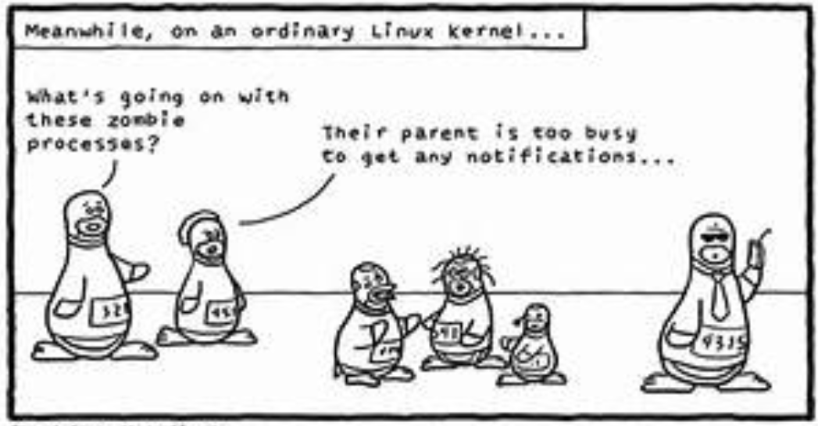
Process Termination

Slide 22
Process Termination in Linux and Unix
Process executes last statement and asks operating system to delete it using exit() or by a return statement in main()
Returns status data from child to parent (via wait())
Process resources are deallocated by operating system
Usually only parent may terminate the execution of children processes using abort()
Child has exceeded allocated resources
Task assigned to child is no longer required
The parent is exiting and the operating systems does not allow a child to continue if its parent terminates
Some operating systems do not allow child to exist if its parent has terminated
cascading termination – all children, grandchildren, ... are terminated
Termination is initiated by operating system

Slide 23
Process Termination (2)
Parent process may wait for termination of a child process by using wait()
Returns status information and the pid of the terminated process
pid = wait(&status);
If no waiting,
Child process is a zombie
Child process is an orphan

Slide 24
Zombie Process
If a parent forks a child, but does not issue a wait() after the child terminates, the terminated child becomes a zombie process
Zombie process – a terminated process whose PCB was not deallocated - i.e., PCB contains child’s exit code such as the code returned by int main()
The child will remain a zombie until the parent calls wait()
Child’s pid and PCB are released
Child’s exit code may be useful to the parent – e.g., to see whether the child has exited with an error

Slide 25
Orphan Process
What if the parent process terminates and did not call wait() on the child?
The child becomes an orphan process
init process becomes the new parent of the orphaned children
init periodically calls wait() to collect the return statuses of orphans and release the orphan’s process pid and PCB

Slide 26

Interprocess Communications

Slide 27

Comic of the Week

Slide 28
Shared Memory

Slide 29
Interprocess Communication (IPC)
A process can either be
Independent – cannot affect or be affected by other processes
Cooperating – can affect or be affected by other processes
Example: if the process shares memory with other processes
Advantages of process cooperation
Information sharing such as exchanging data
Computation speedup – break a task into substasks and execute them concurrently on multiple processors
Modularity – divide system functions into separate processes
Convenience – work on many tasks at the same time, e.g., editing, printing, …
Cooperating processes need interprocess communication (IPC)
Two models of IPC
Shared memory
Message passing

Slide 30
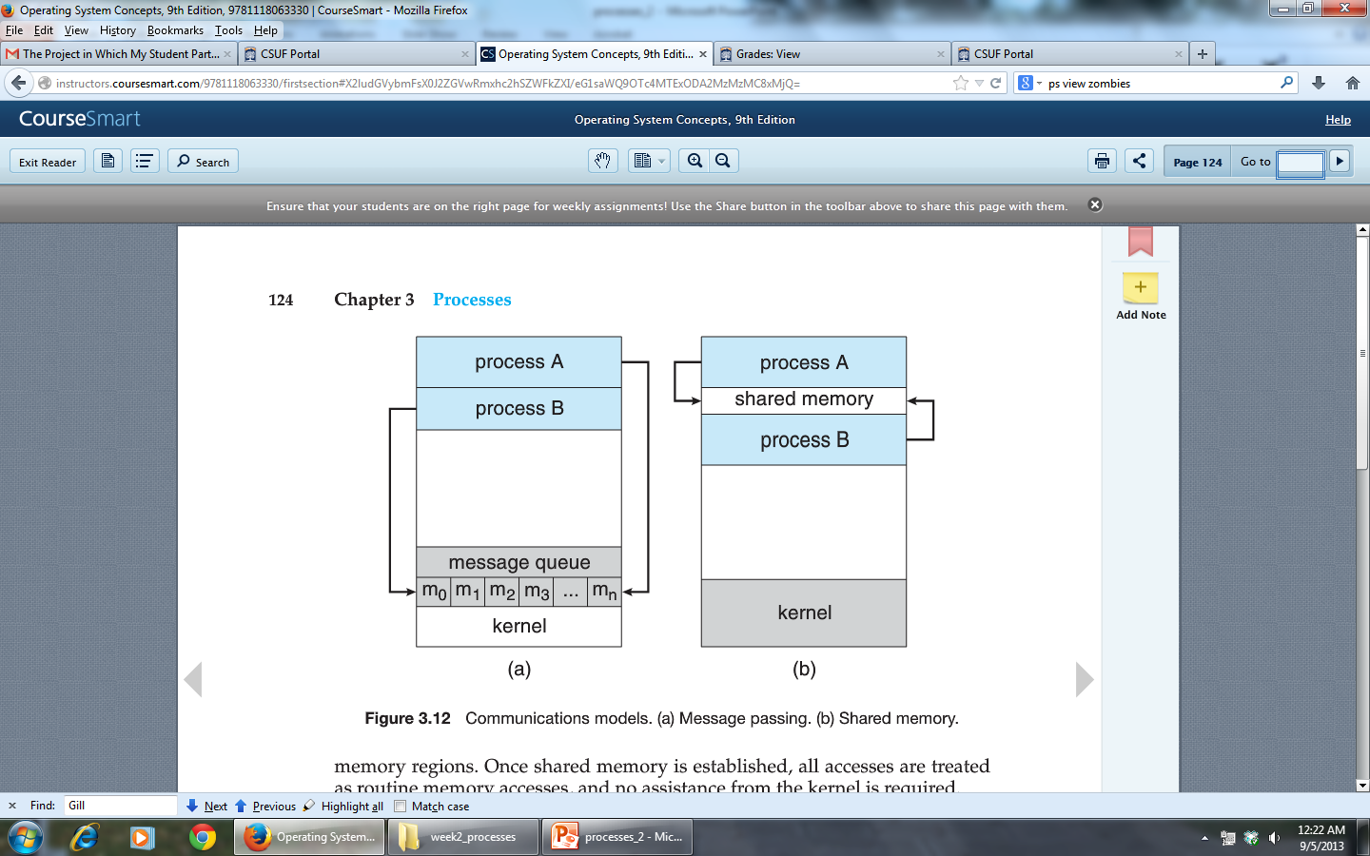
IPC Mechanisms for Cooperating Processes
Shared memory: cooperating processes exchange information by reading/writing data from/to a region of shared memory
Message passing: cooperating processes exchange messages
Shared memory
Message Passing

Slide 31
IPC: Shared Memory vs Message Passing
Shared memory
Faster than message passing: only requires intervention from the OS to establish a shared memory region
Good for large transfers of information
Disadvantage: requires process synchronization to ensure that no two processes write the same memory location at the same time
Message passing
No need for synchronization
Good for small information transfers
Easier to implement than shared memory
Disadvantage: usually requires OS intervention on every message transfer
Can be slower than shared memory

Slide 32
Shared Memory: Producer Consumer Problem
Producer consumer problem: producer process produces information that is consumed by the consumer process
Example: webserver process produces HTML that is consumed by the web browser
Solution: use shared memory
Approach 1: unbounded buffer places no practical limit on the size of the buffer
Producer can always produce new items
Consumer may have to wait for new items
Approach 2: bounded buffer assumes a fixed buffer size
Producer must wait if the buffer is full
Consumer must wait if the buffer is empty

Slide 33
Producer Consumer Problem: Bounded Buffer Implementation
Example
Variables reside in a region of memory shared by producer and consumer
#define BUFFER_SIZE 10
typedef struct {
. . .
} item;
item buffer[BUFFER_SIZE];
int in = 0; // First empty position in “buffer”
int out = 0; // First full position in “buffer”
// The buffer is empty when in == out
// The buffer is full when ((in+1) % BUFFER_SIZE) == out

Slide 34
Producer Code
Consumer Code
item next_produced;
while (true) {
/* do nothing -- no free buffers */
while ((in + 1) % BUFFER_SIZE
== out);
// Produce an item
next_produced = …..
// Save the produced item
buffer[in] = next_produced;
// Compute the next free index
in = (in + 1) % BUFFER_SIZE;
}
item next_consumed;
while (true) {
// No items to consume
while (in == out) ; // do nothing
// Consume an item
next_consumed = buffer[out];
// Compute the index of the next item
// to consume
out = (out + 1) % BUFFER_SIZE;
return item;
}
Problem: what if producer and consumer try to access the same buffer slot concurrently?
Solution: process synchronization (discussed in great details in Chapter 5)

Slide 35
IPC Shared Memory Summary
An area of memory shared among the processes that wish to communicate
The communication is under the control of the users processes not the operating system
Major issues is to provide mechanism that will allow the user processes to synchronize their actions when they access shared memory (to be discussed in Chapter 5)

Slide 36
IPC POSIX Shared Memory Example
Example: Processes P₁ and P₂ want to communicate using shared memory-mapped files that associate the region of shared memory with a file
Assume that we want P₁ to be responsible for allocating the shared memory segment
P1:
Step 1 – creates a shared memory segment
shm_fd = shm_open(name, O_CREAT | O_RDWR, 0666);
name: the name of shared-memory object
O_CREATE specifies the shared-memory object is to be created if it does not yet exist
O_RDRW specifies the object is open for reading and writing
0666 establishes the directory permissions of the shared-memory object
shm_fd: file descriptor for the shared-memory object if successful
Step 2 - sets the size of the object in bytes
ftruncate(shm fd, SIZE); // set SIZE = 4096
Step 3 – establishes a memory-mapped file with shared-memory object
addrPtr = nmap(0, SIZE, PROT_WRITE, MAP_SHARED, shm_fd, 0);
PROT_WRITE indicates pages may be written
MAP_SHARED shares the mapping to all processes mapping to this object
Step 4 - writes to the shared memory
sprintf(addrPtr, "Writing to shared memory");
P2: follows the same steps as P1 except
Calls shm_open with O_RDONLY, nmap with PROT_READ, printf
No call to ftruncate to configure the size of the shared-memory object

Slide 37
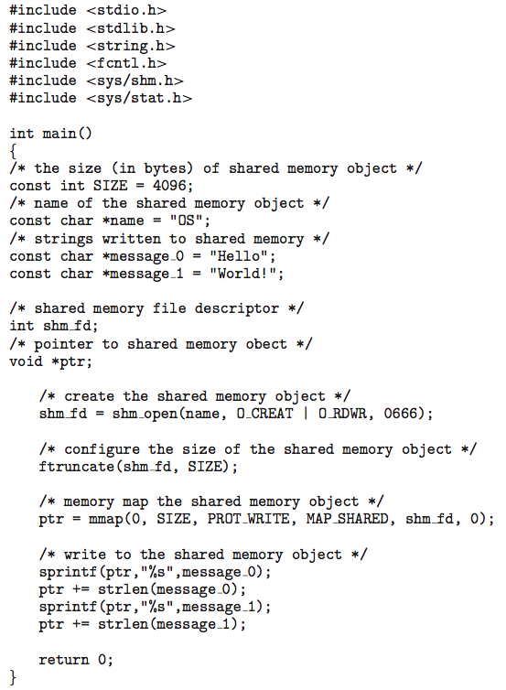
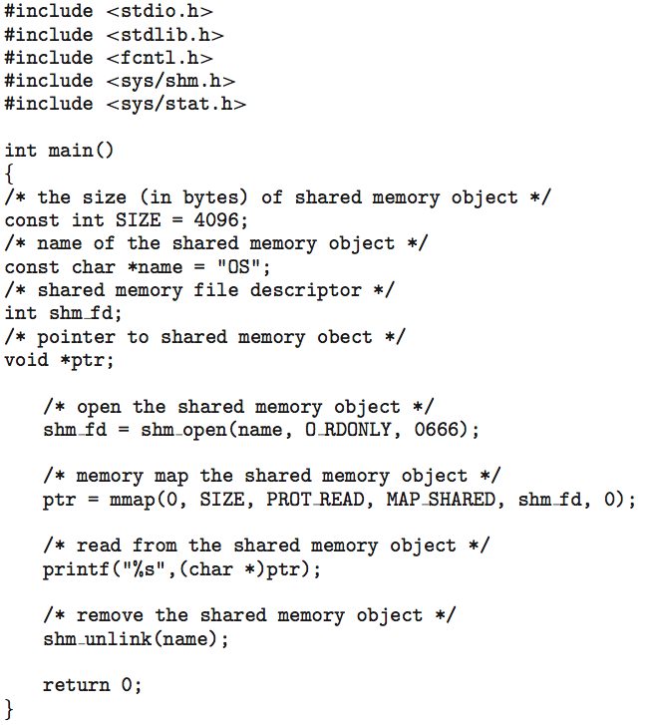
Producer
Consumer

Slide 38
Messaging Passing

Slide 39
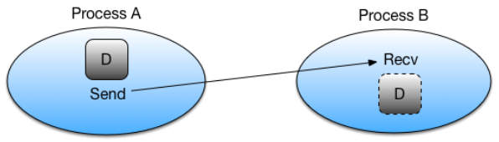
IPC: Message Passing
Mechanism for processes to communicate and to synchronize their actions
Establish a communication link between communicating processes
Exchange messages via send(message) and receive(message)
Messages can be either fixed-sized or variable-sized
Fixed-sized: easier to implement, but imposes limitations
Variable-sized: harder to implement, but is more flexible
Different logical implementation of communication link
Direct or indirect communication
Synchronous or asynchronous communication
Automatic or explicit buffering

Slide 40
Message Passing – Direct Communication
Processes must explicitly name the sender or the receiver explicitly
Symmetrical direct communication – both communicating processes must explicitly name the sender or the receiver
send(P, message): send a message to process P
receive(Q,message): receive a message from process Q
A link is established automatically between every pair of processes
Each link is exactly between two processes
Between each pair of processes, there exists only one link
Asymmetrical direct communication – similar to symmetrical, but only the sender must explicitly name the receiver
send(P, message): send a message to process P
receive(id, message): receive the message from any process and save the sender’s id in id
Disadvantage: if the process changes the identifier, we must change the identifier in all places that use it
Example: the receiver process saves all messages. If sender changes its identifier, receiver must change it in all saved messages

Slide 41
Message Passing – Indirect Communication
Indirect communication: processes use mailboxes or ports to send/receive messages
send(A,message): send message to mailbox A
receive(A,message): receive a message from mailbox A
There is a link between two processes only if they share a mailbox
A link may be associated with more than two processes
Each pair of communicating processes must share a mailbox
Mailbox sharing: processes P₁, P₂, and P₃ share mailbox A
Process P₁ places a message into A
Both P₂ and P₃ execute receive. Who should get the message?
Solutions:
Restrict one link to at most two processes
Allow only one process at a time to execute receive
Select the receiver arbitrarily and notify the sender of the receiver’s id

Slide 42
Synchronization
How can send() and receive() be implemented?
Message passing may be either blocking or non-blocking
Blocking is considered synchronous
Blocking send -- the sender is blocked until the message is received
Blocking receive -- the receiver is blocked until a message is available
Non-blocking is considered asynchronous
Non-blocking send -- the sender sends the message and continue
Non-blocking receive -- the receiver receives either
A valid message, or
A null message
When both send() and receive() are implemented as blocking ➔ there is a rendezvous between the sender and the receiver
The receiver blocks until the message is available
The sender blocks until the receiver gets the message

Slide 43
Synchronization: Producer-Consumer
Producer-consumer problem is trivial with blocking send() and receive()
Producer process using message passing
Consumerprocess using message passing
message next_produced;
while (true) {
/* produce and item in
next produced */
next_produced = …..
send(next_produced);
}
message next_consumed;
while (true) {
receive(next_consumed);
/* consume the item in
next_consumed */
}
Producer calls blocking send(…) and waits until the message is delivered to either the receiver or mailbox
Consumer calls blocking receive(…), it blocks until a message is available

Slide 44
Buffering
Messages exchanged between processes must be placed in a temporary queue
3 approaches:
Zero capacity (no buffering): the queue has a maximum length of zero ➔ no messages waiting in the link
Sender must block until the message is received
Bounded capacity: the queue has a finite capacity. When the capacity is exceeded, sender must block until space is available in the queue
Unbounded capacity: any number of messages can be placed in the queue; the sender never blocks

Slide 45
IPC Mach Message Passing Example
Mach: an OS developed at Carnegie Mellon
All communications are based on message passing
Even system calls are messages
Each task gets two mailboxes at creation: Kernel and Notify
Three system calls used for message transfer:
msg_send()
msg_receive()
msg_rpc()
Mailboxes needed for communication, are created using port_allocate()
Send and receive are flexible – four options if mailbox full
Wait indefinitely
Wait at most n milliseconds
Return immediately
Temporarily cache a message

Slide 46
Next Class
Finish Chapter 3
Chapter 4: Threads
In-class Questions and Answers

Slide 47
References
Operating System Concepts, 9th Edition, Abraham Silberschatz, Peter Baer Galvin, Greg Gagne
Chapter 3

